Slide 1

DevOps

Slide 2



Objectives
What is DevOps
DevOps Lifecycle
Benefits of DevOps
Artificial Intelligence /Machine Learning for DevOps
Top 5 Companies using DevOps in 2021
Real-time Use Case of DevOps
Conclusion

Slide 3

What is DevOps ?
DevOps is a combination of two terms Dev and Ops
DevOps is a collection of methods, technologies, and a mindset that automates and integrates software development and IT teams' processes

Slide 4
DevOps Lifecycle
Continuous Integration
Testing
Monitor & Alert
Continuous Feedback
Planning
&
Build
Deployment
Operation

Slide 5
DevOps Lifecycle(Contd..)
Plan & Build - The teams following DevOps would need to adapt to the latest agile practices This would mean breaking the software development lifecycle into smaller incremental chunks
Continuous Integration – New functionality is introduced and integrated with the existing developed product
Testing – The Main purpose of this phase is to identify the bugs present in the developed application. Automation testing tools like TestNG, JUnit, and Selenium are used for testing
Monitor & Alert – A DevOps team is quick to identify and resolve any issues related to the product

Slide 6
DevOps Lifecycle(Contd..)
Continuous feedback – The DevOps team will evaluate themselves with each release. These feedback will be put into a report so the team’s performance can be analyzed and any processes can be streamlined. It is essential to incorporate customer / end-user feedback for this step
Deployment – This phase ensures the deployment of code onto the production servers. some popular tools are: Chef, Puppet, and SaltStack
Operation - All DevOps operations are built on a foundation of consistency and total automation of the release process, allowing the company to continually reduce its overall time to market

Slide 7

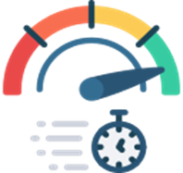

Benefits of DevOps
Foster greater collaboration and trust within the team as well as outside because the team has shared responsibility for the product(s) they develop and maintain.
With increased collaboration, the development cycles are shorter and more efficient. The quality/quantity of releases is much higher and more time can be dedicated to exploratory work.
Static and dynamic tests, unit testing, integration testing, and dependency scanning are all used by DevOps to see if the product has any vulnerabilities

Slide 8



Benefits of DevOps(Contd..)
Streamlines the development process as a whole
DevOps teams improve products quickly by boosting the frequency. Quick deployment of new features and fixing bugs might give a competitive advantage
The teams are able to cope with customer demands and focus on delivering a competent product

Slide 9





Top 5 companies using DevOps

Slide 10
Real-time use cases
Amazon is an American Multi-National Company. It provides a variety of streaming content throughout the world using applications like Amazon Prime Video, Amazon Music, Twitch, Audible units, etc
Problem was monolithic architecture

Slide 11
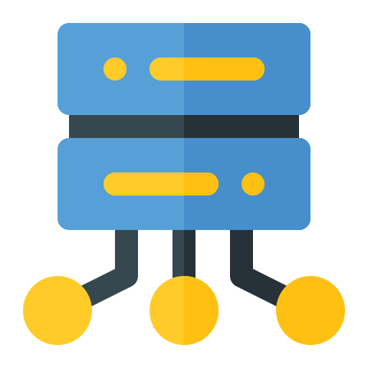


Real-time use cases
Threads
Users
Posts
AWS uses CodeDeploy, to keeps track of deployments and streamlines the software processes
Apollo, a one-click internal deployment tool, is used by Amazon

Slide 12
Conclusion
DevOps establishes a smooth path for Continuous Development and Continuous Integration by bridging the gap between developer team and operational team. So, this was all about the DevOps and use cases of DevOps in the real world.
Are you seeking for the best DevOps certification education online? Simplilearn offers amazing DevOps Certification courses delivered by top subject matter experts. Enroll now for a fantastic hands-on experience. Visit Simplilearn's official website for a better understanding https://www.simplilearn.com/

Slide 13


